Slide 1
ENGR 290
Dislocations

Slide 2
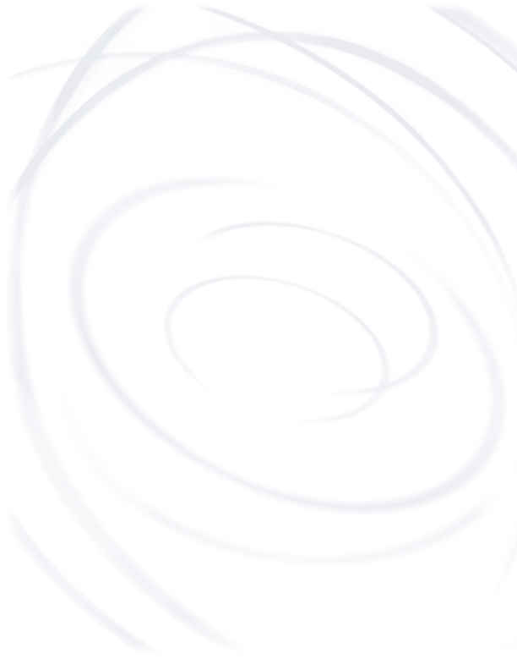
Objectives (Chapter 4)
At the end of this lecture you should be able to:
Define four types of imperfections in common solids
Define the different types of vacancies
Define a Frenkel imperfection
Define a Schottky defect
Draw edge and screw dislocations.
Define and draw a Burger’s vector.
Describe the structure of planar defects and grain boundaries
Describe methods to strengthen materials by blocking dislocation motion
Show the relationship between grain size and material strength
Apply Schmid’s Law

Slide 3
Dislocations
Dislocations are very important, perhaps THE most important imperfection in real materials.
Dislocations are line imperfections in otherwise perfect lattices.
Dislocations are formed during solidification because of thermal contraction stresses or when the material is deformed.
Dislocations strongly affect the mechanical, electrical and photonic properties of materials.

Slide 4
Dislocations
There are two basic types of dislocations
    edge and screw.
Dislocations are described by the following three crystal structures.
    Burgers vector
    line direction
    habit plane

Slide 5
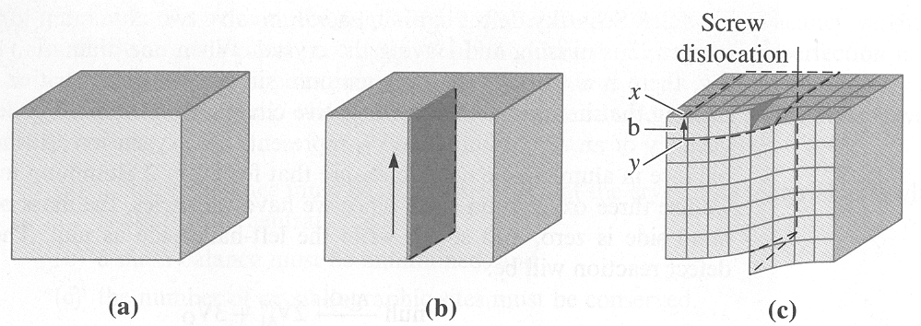
Screw Dislocation
u
The perfect crystal in a) is cut and sheared one atom spacing in b) and c). The line along which the shearing occurs is a screw dislocation. A Burgers vector, b, is required to close a loop of equal atom spacings around the screw dislocation. The Burgers vector and screw dislocation line direction, u, are in the same direction so there is no habit plane, just a line. The line though exists on an atomic plane called a habit plane or glide plane.

Slide 6
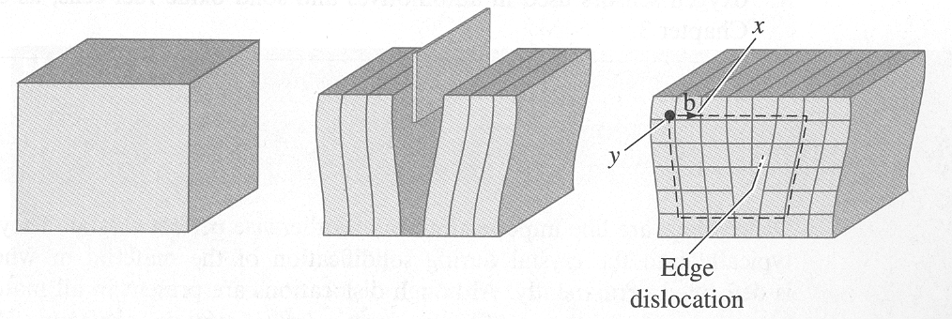
Edge Dislocation
u
a)
b)
c)
The perfect crystal in a) is cut and an extra plane of atoms is inserted in b). The bottom edge of the extra plane is an edge dislocation in c). A Burgers vector b is required to close a loop of equal atom spacings around the edge dislocation. b is perpendicular to the dislocation line direction, u, so there is a habit plane, which most often lies on a close packed atomic plane, often the glide plane.
What are these planes for FCC and BCC materials?

Slide 7
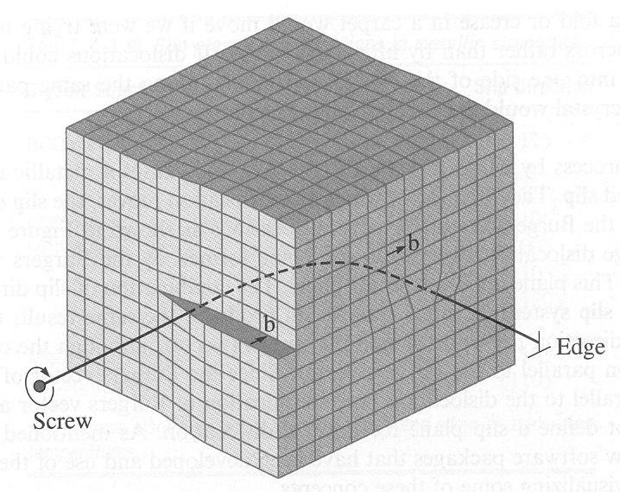
A mixed dislocation showing a screw dislocation at the front of the crystal gradually changing to an edge dislocation at the side of the crystal. Note that the line direction of the dislocation lying on the glide plane is parallel to the Burgers vector of the screw dislocation and perpendicular to the edge dislocation.

Slide 8
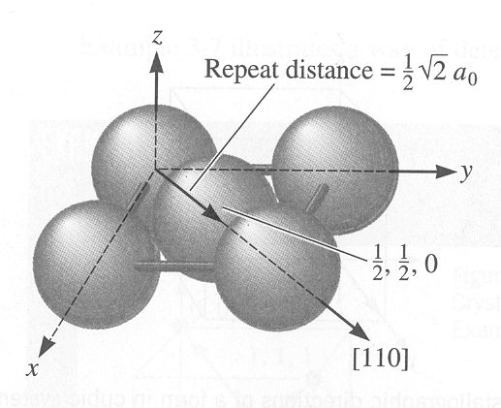
Repeat Distance
A means to characterize crystal directions is by the repeat distance or distance between the lattice points or atomic positions along a direction.
For example, for a FCC crystal, if we start at 0, 0, 0 location the next closest lattice point is at the ½, ½, 0 site.
The distance is then ½ of the face diagonal as shown below.
For FCC dislocations
B = a_{o}/2 <110>{111}

Slide 9
Dislocation’s Burgers Vector
See, example 4-7 - Calculate the length of the Burgers vector in copper.
Note that often the Burgers vector is the repeat distance between the atoms in the close packed plane.
Since BCC materials don’t have close packed planes, the ones often used have high densities such as the {110} and {112} planes gliding in the <111> directions on those planes.
For BCC dislocations
B = a_{o}/3 <111>{110} or B = a_{o}/3 <111>{112} or B = a_{o}/3 <111>{113}

Slide 10
Surface Defects
Surface defects are another type of imperfection in real materials.
They consist of the boundaries or planes that separate a material into regions of different crystal structures or orientations.
  The material’s surface is one example
  Grain boundaries are another example of a surface defect.
  Others are stacking faults, twin boundaries and magnetic domain boundaries
Grain boundaries are narrow zones where the atoms are not properly spaced in which tension or compression exists.
Grain size influences many material properties such as strength and electrical conductivity.
  What is a grain?

Slide 11
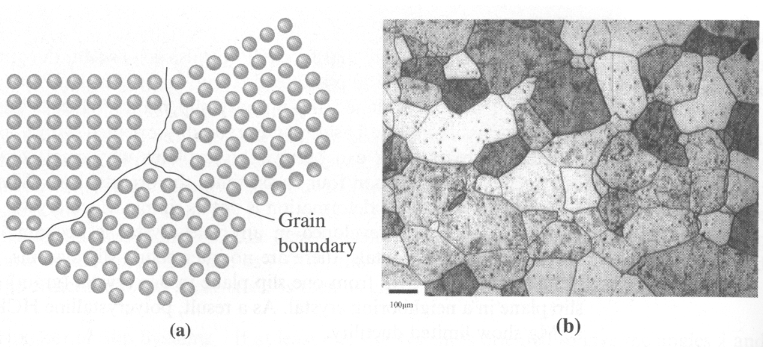
Grain boundaries showing in a) that the atoms at the boundaries near the three grains (referred to as a triple point) do not have an equilibrium spacing and in b) grains in a stainless steel sample. (The black spots are little crystals in the grains, not dirt, called precipitates, which produce interface boundaries with their host crystal.)

Slide 12
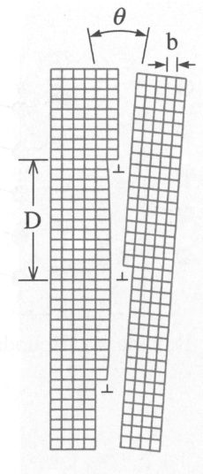
The angle, θ, of a tilt boundary is made from three dislocations and can be described by the equation below.
b
θ/2
2D
Note: grain boundaries are actually a two-dimensional network of dislocations.
Grain boundaries are very important defects in materials with the smaller the grains, the more grain boundary area -> nanotechnology.

Slide 13
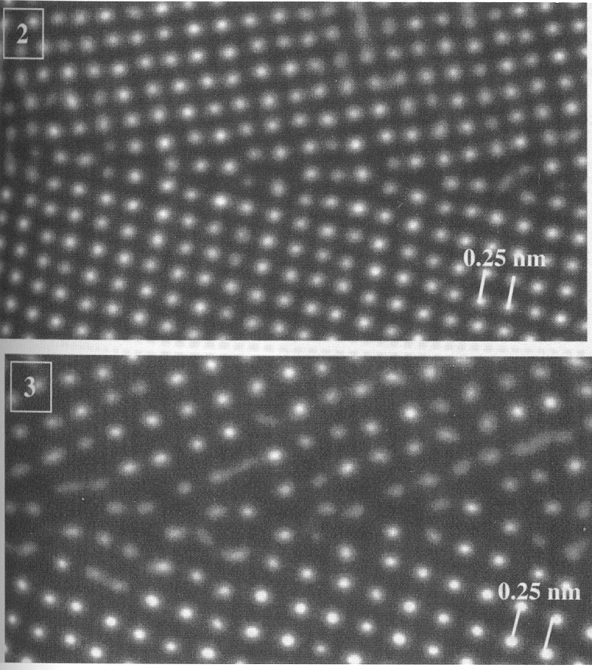
Low angle grain boundaries in Cubic Zirconia seen using a Transmission Electron Microscope
Note that the lower grain boundary having higher tilt angle is strained more than the above grain boundary as seen by the fuzzier atomic positions.
What might cause the fuzziness?
Dickey et. al., Microscopy and Microanalysis (2000) pg. 120

Slide 14
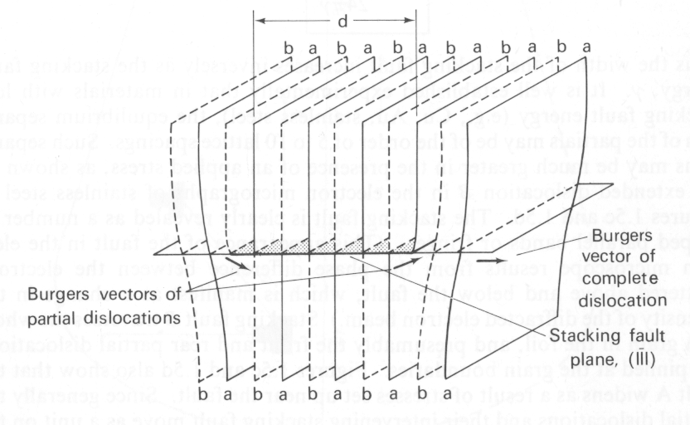
Stacking Faults
A stacking fault is shown where atomic column “a” is interfaced with atomic column “b”, which resulted from the partial dislocations (i.e., one dislocation splitting into two dislocations) found on either end of the stacking fault. The theoretical strength of the material (elastic modulus) is proportional to the stacking fault energy.

Slide 15
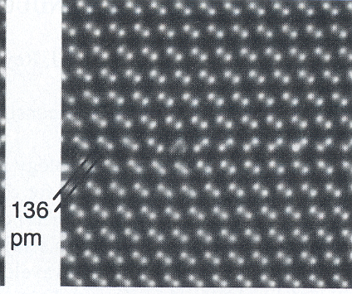
Atomic lattice image of a "Stacking fault" in GaAs showing reverse ordering of Ga and As planes. Note the partial dislocation at the start of the fault (in circle).
Kisielowski et. al. Microscopy and Microanalysis (2000) pg. 16

Slide 16
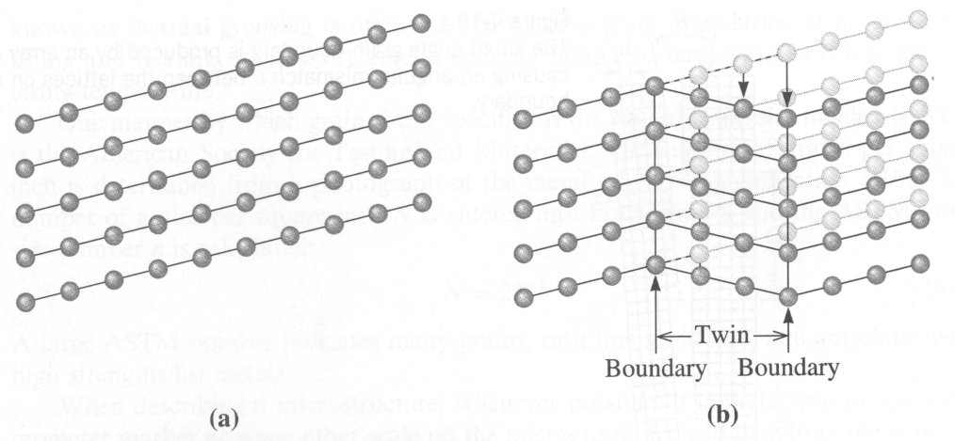
Twin Boundary
A twin boundary, which is a planar defect, is the displacement of atoms caused by a stress that reorients a volume of the crystal, which is bounded by the twin boundary.
Twin boundaries have partial dislocations at their beginning and end that initiate the crystal rotation.

Slide 17
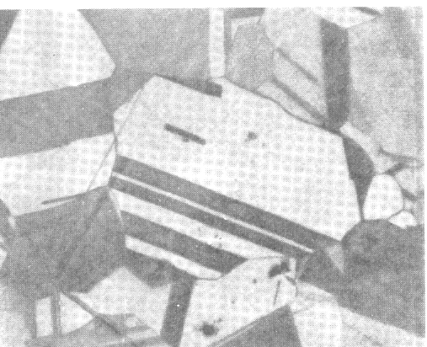
Twins
Brass, a copper zinc alloy, deforms by the formation of twins. The twin boundaries are at the interface of the dark-white lined regions.
In which direaction did the material deform in this micrograph?

Slide 18
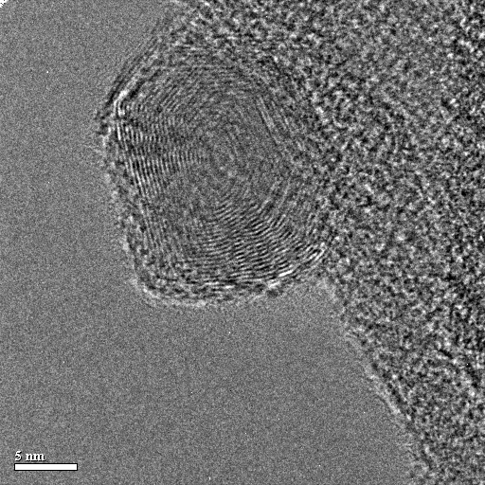
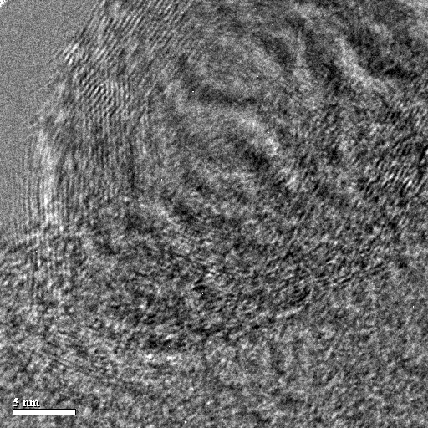
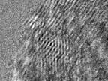


Twin boundaries, stacking faults and dislocations found in this small LaF₃ crystals. The Lanthanide materials are light emitting diodes being developed in Chemistry at UVic.

Slide 19
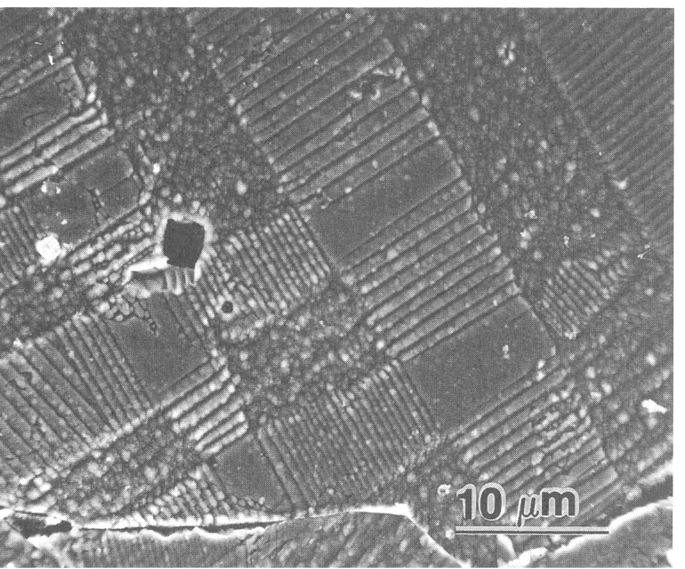
Magnetic Domain Boundaries
Magnetic domain boundaries in ferroelectric barium titanate, a magnetic material used for memory storage devices.
(many other defects are readily seen)

Slide 20
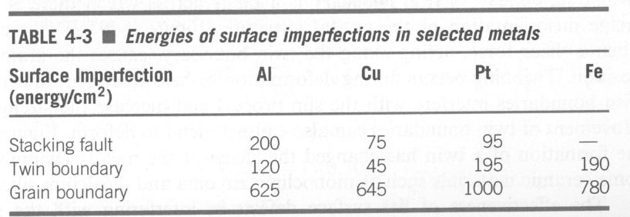
Why do stacking faults form in Al, Cu and Pt but not in Fe?
Why do grain boundaries take so much energy to form? Why don’t other defects just form instead?
Why do defects form in materials in the first place?

Slide 21
Control of Dislocations
Control of dislocations allows us to manipulate mechanical properties and understand their temperature dependence.
When a shear force acting in the direction of the Burger’s vector is applied to a crystal containing a dislocation, the dislocation can move by breaking bonds between the atoms in one plane.
By this process, the dislocation moves on its glide plane through the crystal to produce a step on the exterior of the crystal.
The process by which the dislocation moves and causes a solid to deform is called slip.

Slide 22
Dislocation Slip
Dislocations move more readily in some crystal planes and directions than in others as we will see.
The slip direction of an edge dislocation is in the direction of the Burger’s vector.
A slip plane is defined by the direction of the Burger’s vector and the line direction of the edge dislocation.
As stated before,
  The line direction, u, of a screw dislocation is in the same direction as its Burger’s vector, b.
  An edge dislocation has its Burger’s vector perpendicular to the line direction of a dislocation
  A dislocation having a line direction not parallel or perpendicular to the Burger’s vector is considered a mixed dislocation.

Slide 23
Dislocation Slip
During slip, the dislocation moves from one set of surroundings to another identical set.
The least amount of energy expenditure requires movement, i.e. slip direction, in directions in which the repeat distance is the shortest, i.e., close-packed directions.
Slip reduces strength but increases ductility in materials. Many materials need ductility for their fabrication into a product.
Slip planes tend to be those planes with a high planar packing, i.e., close packed planes.

Slide 24
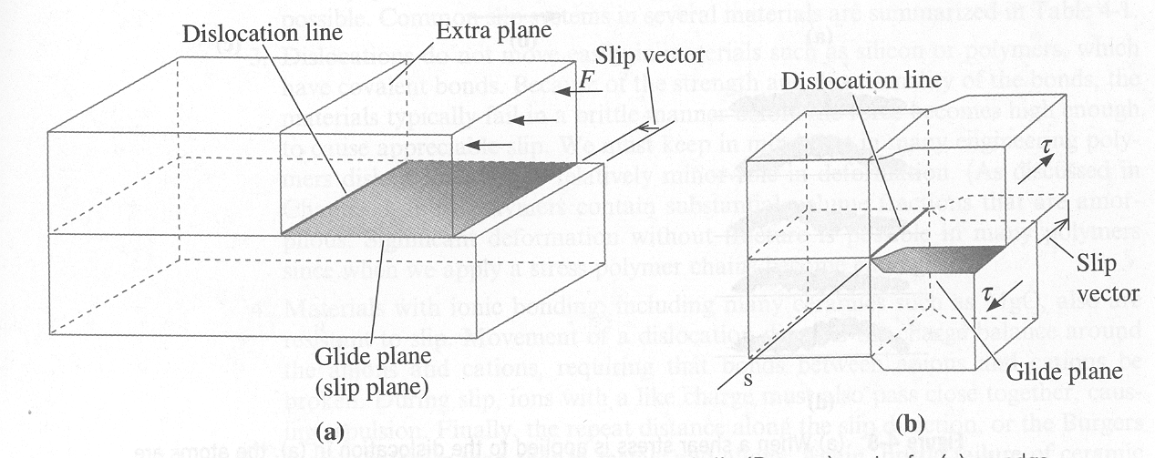
b
b
Schematic of slip line, slip plane and slip vector (Burgers vector) for a) an edge dislocation (force) and b) a screw dislocation (shear).
Note the relationships between the dislocation line, slip vector and glide plane . Slip vectors are parallel to the Burgers vectors.
The same screw dislocation can actually slip on many equivalent but different planes enabling it to move from one plane to another referred to as cross-slip.

Slide 25
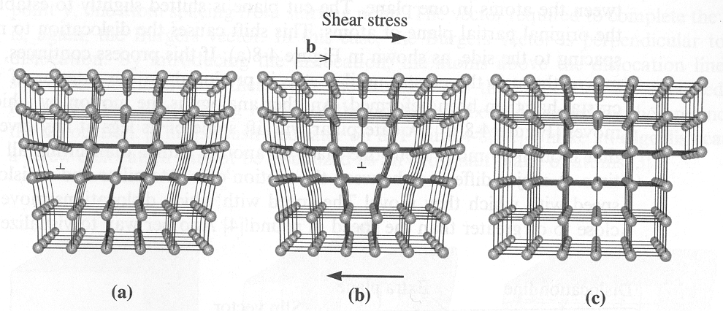
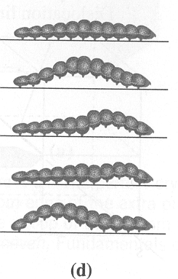
When a shear stress is applied to the dislocation in a) the atoms are displaced, causing the dislocation to move one Burgers vector in the slip direction b). Continued movement of the dislocation creates a step the surface c) and the crystal is deformed. Motion of a caterpillar (or a fold in a rug) is analogous to the motion of a dislocation.
Note: the slip direction is always in the direction of the Burgers vector of the dislocation.

Slide 26
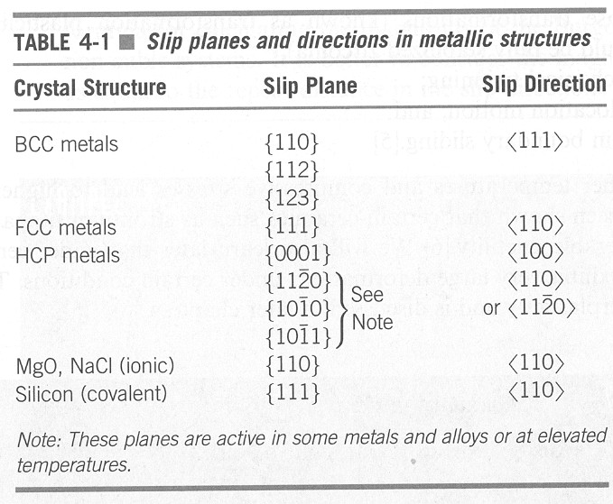
not close
packed planes
close
packed
directions
close
packed planes
*
* - Note Silicon, i.e. diamond cubic, is similar to FCC metals.

Slide 27
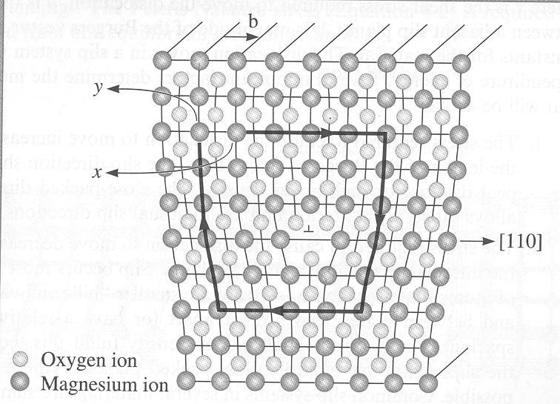
Ceramics
An edge dislocation in MgO.
Dislocations in ceramics and semiconductors are complicated by ionic charges existing at their core requiring large energies for them to glide.
If these dislocations can’t glide, how do they move/deform?
See also Example 4-6 in Askeland and Wright for the calculation of the length of the Burgers vector of a dislocation.

Slide 28
Dislocation Cores
At the dislocation core, there are dangling electron bonds.
In metals where conduction of electrons is everywhere, the dangling electrons do not influence charge mobility except by offering resistance to electrons traveling along atomic planes.
In semiconductors and ionic materials (insulators, dielectric materials), the charges existing at the dislocation core have a significant impact on many of the materials properties such as strength and toughness, but also electronic, sensor and magnetic properties.

Slide 29
Dislocation Cores
Dangling electron bonds
Charges at the dislocation core can disrupt or short out electronic and sensor devices causing failure.
The dislocations often glide by some means into the active region of a device and short it out like a wire.
Most electronic devices fail by this mechanism.
High temperatures are often not necessary for failure just electrostatic charge differences between the dislocation and active region of the device.

Slide 30
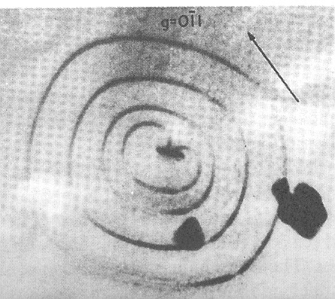
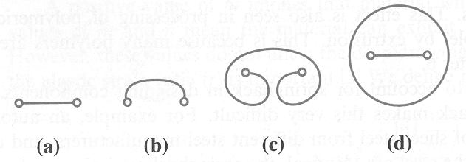
Cold Working/Strain Hardening - Dislocations
One common mechanism for the creation of the dislocation is to form a Frank-Read source where a dislocation is pinned at both ends and an applied stress causes it to bow outward to form a loop, which pinches off to enable another dislocation to form. See below.

Slide 31
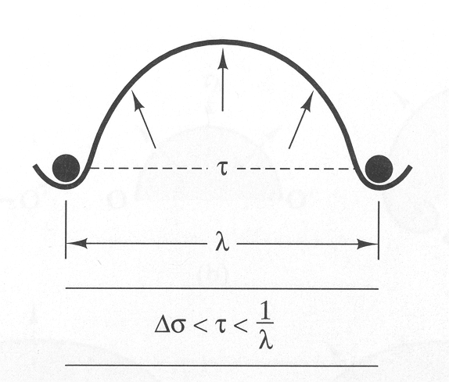
Dispersion Strengthening
precipitates
Dislocation motion blocked by particles or precipitates increase the strength of the material.
As the distance between precipitates, λ, decreases, the line tension, τ, of the dislocation increases as does the change in stress, Δσ, required to move the dislocation.
This is an important method for strengthening materials, as the precipitates provide barriers to dislocation motion.

Slide 32
Observing Dislocations
We can view dislocations indirectly by etching the surface of a material. Where the dislocation intersects the surface, it is preferentially etched creating an etch pit, which can easily be seen optically.
Using a transmission electron microscope, we can see the strain contrast that a dislocation makes as it passes through a crystal, or at the atomic level we can see the displacement of atomic columns due to the presence of a dislocation.

Slide 33
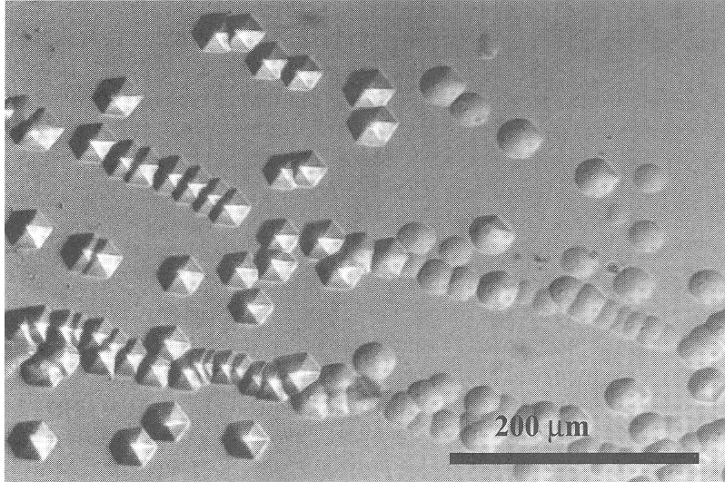
Optical etch pits in Silicon Carbide (SiC) corresponding to the surface intersection of pure edge dislocations having and a line direction of [0001], which is perpendicular to the etched surface.

Slide 34
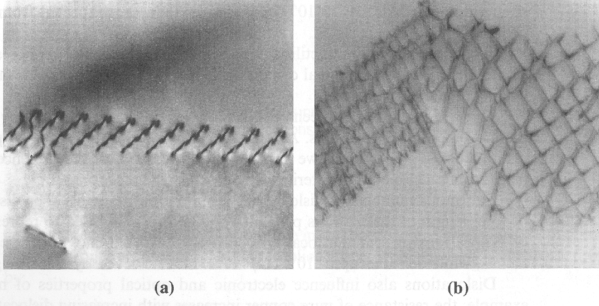
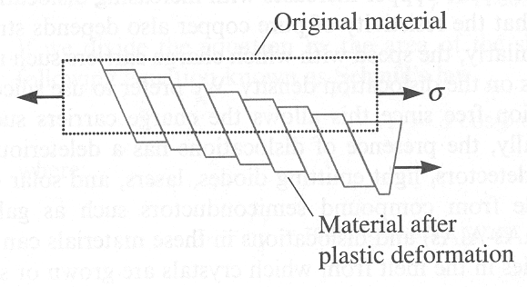
Strain fields of dislocations in Ti₃Al seen by TEM showing dislocation pileups in a) and b) and how they contribution to permanent or plastic deformation in c).
(c)

Slide 35
Defects in Plasma Crystals Grown in Space
Because the environment in space (e.g., the international space station) is very quiescent, we can grow plasma crystals, which are small (0.1 mm diameter) ceramic particles having a positive charge in the center and negative charge around the particle, similar to the Bohr model of the atom.
The microgravity (10⁻⁶ g) in space removes convection in fluids.
We can learn from plasma crystals grown in space the behavior of point defects, line defects and surface defects, as well as,
they can be used to give insight into physical phenomena, which is otherwise unobservable terrestrially, such as,
the transition between solid – liquid – gas.

Slide 36
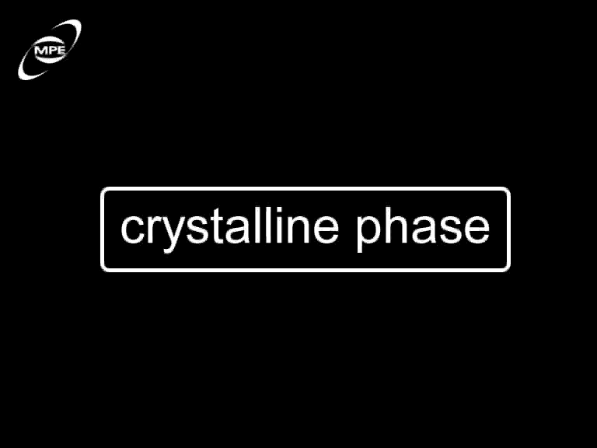
The Melting of a Plasma Crystal

Slide 37
Plasma Crystals Grown in Space
So, what can we learn from plasma crystals grown in space?
They give insight in physical phenomena, such as,
The formation and movement of defects.
The transition between solid – liquid – gas.
The phase separation (different crystal structures formed by small and large atoms – later we shall see)
Convection at interfaces
Flow of heat via phonons (lattice vibrations – we shall see later).
Etc.

Slide 38
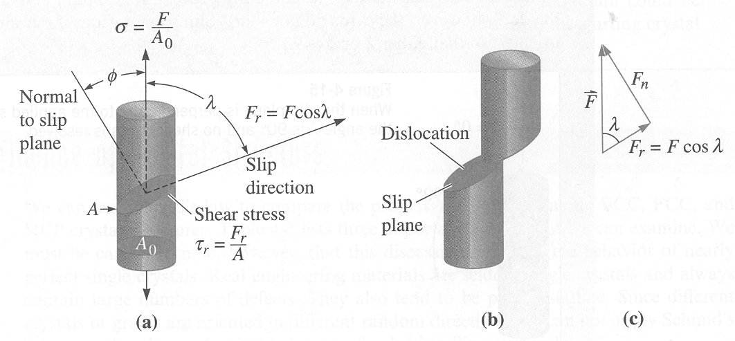
Schmid’s Law
We can control the deformation behaviour in materials using Schmid’s Law, which takes into account the orientation of an applied force and the possible slip directions and slip planes.
The unidirectional stress, σ, applied to the cylinder and its resolved shear stress, τ, in the slip direction is given by:
See examples 4-9 in Askeland and Wright.

Slide 39
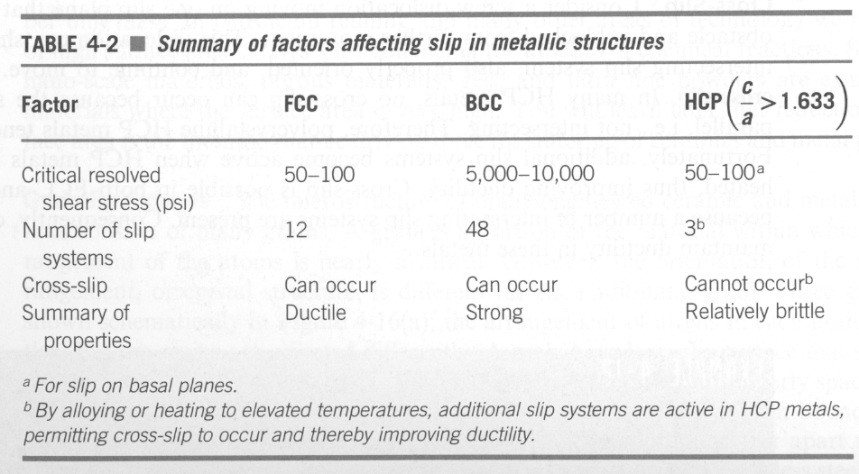
Cross-slip means that the dislocations can change or move from one slip plane to another.
CRSS of BCC materials are high because they don’t have close packed planes, thus more resistance to dislocation glide increasing strength.

Slide 40
Control of Slip Process – Strengthening Mechanisms
We can control the strength of a material by controlling the number and type of imperfections in real materials.
  These imperfections block the movement of dislocations making it difficult for dislocation motion.
Five common mechanisms for increasing the strength of a material are:
Strain hardening
Solid solution strengthening
Grain refinement
Secondary phases
Dispersion hardening (age hardening)

Slide 41
Control of Slip Process – Strengthening Mechanisms
1) strain hardening, which increases the number of dislocations in the material by deforming the material. The extra dislocations block the motion of other dislocations by their strain fields. Thus, strain hardening is enhanced with increased dislocation density.
2) solid solution strengthening, which adds point defects consisting of substitutional or interstitial atoms (alloying additions or impurities, i.e., foreign atoms). The strain around the foreign atoms blocks the motion of dislocations.
3) grain size strengthening (grain refinement), which reduces grain size where the grain boundaries (two-dimensional network of dislocations) block the motion of dislocations. The greater the grain boundary area (smaller grain size) the greater the strength of the material.

Slide 42
Control of Slip Process – Strengthening Mechanisms
4) Secondary phases where some grains can have one type of atomic structure, eg., bcc, and other grains will have another type of atomic structure, eg., fcc. An example is α/β brass. Dislocations have difficulty passing from one type of grain to the other.
5) Dispersion hardening (age hardening) where small precipitates having different crystal structures within grains are used to block the motion of dislocations.

Slide 43
Strengthening Mechanisms
These five processes are used to increase the strength of a material.
During this course we will discuss these five mechanisms in greater detail.

Slide 44
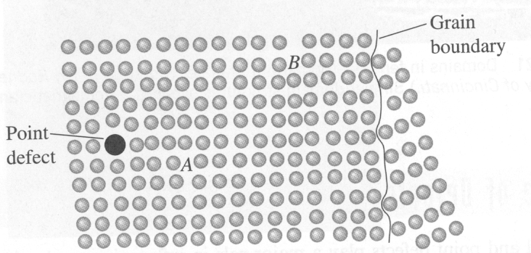
If the dislocation at point A moves to the left, it is blocked by the point defect. If it moves to the right, it interacts with the dislocation at B and farther to the right, with the grain boundary.

Slide 45
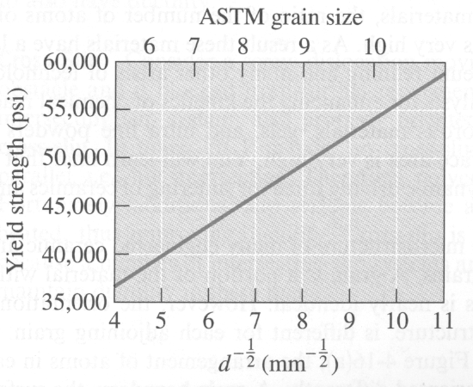
The effect of grain size on the yield strength of steel at room temperature where the Hall-Petch equation applies:
Review example 4-12 in Askeland and Wright.

Slide 46
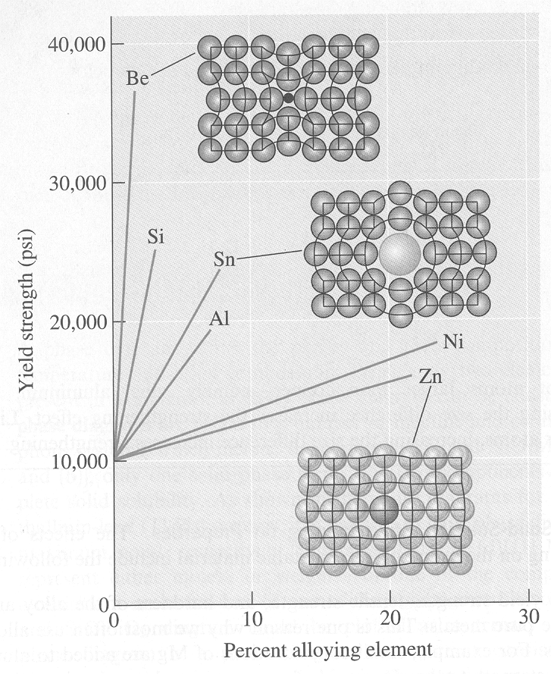
Solid Solution Strengthening
Engineers can strengthen alloys by the addition of solutes, which add strain to the crystal helping to block the motion of dislocations.
Small solutes such as Be tend to give a bigger increase in strength than larger solutes, eg. Sn, Ni or Zn. See graph. An example we will see later is Cu-Be alloys.
Small solutes give a bigger “bang for the buck”!
100% Cu

Slide 47
The End
(Any Questions?)

